Slide 1

Revolutionizing
E-Learning
Our e-learning platform strives to revolutionize education by offering a diverse range of features that cater to educators, students, and professionals. With a focus on innovation and inclusivity, our platform aims to provide a dynamic learning environment that meets the evolving needs of the global learning community.

Slide 2

Best-in-Class Content
Diverse Content
Our platform offers a wide array of educational content, covering a variety of subjects and interests to meet the diverse needs of learners.
Engaging Material
We provide informative and engaging material, incorporating cutting-edge resources to keep users captivated and motivated to learn.
High-Quality Resources
Users have access to high-quality resources that facilitate comprehensive learning experiences, ensuring their educational success.

Slide 3
User Authentication and Progress Tracking
1
Secure Access
2
Personalized Progress Tracking
3
Data-Driven Insights
Our platform ensures secure user authentication to protect user data and provide a safe online environment.
Utilizing user data, our platform provides data-driven insights to guide users on their learning path, enhancing their overall experience.
Users have access to personalized progress tracking, allowing them to monitor their learning journey and set goals.

Slide 4
Comprehensive Study Materials
Previous Year Papers
Solved PYQs
Detailed Study Guides
Access to previous year papers for comprehensive study preparation and assessment.
Extensive collection of solved previous years' questions to aid learning and test preparation.
Comprehensive and detailed study guides to assist users in understanding complex concepts.

Slide 5

Interactive Community Section
1
Engaging Discussions
A platform for vibrant and engaging discussions to promote peer-to-peer learning and knowledge sharing within the community.
2
Interactive Knowledge Sharing
An interactive space where users can exchange knowledge, collaborate, and support each other in their learning endeavors.
3
Diverse User Participation
A community section that encourages diverse user participation, fostering a culture of inclusivity and collaborative learning.

Slide 6



Collaborative Features: Chats and Connections
Personalized User Connections
Engaging Group Discussions
Opportunities for dynamic interactions and engaging group discussions, enabling collaborative learning experiences.
Users have the ability to connect and network with others who share similar academic or professional interests, fostering valuable connections.

Slide 7

Chapter-Specific Assignments
Diverse Subject Areas
Skill-Based Tasks
Assignment Library
Users have access to chapter-specific assignments across a broad range of subject areas, promoting comprehensive learning.
Assignments that are designed to develop and enhance specific skills, catering to individual learning needs and goals.
A comprehensive assignment library that supports diverse learning objectives and academic requirements.

Slide 8



Programming languages:
Practice and Proficiency
Language Proficiency Development
Practice Exercises
Access to practice exercises for every language to enhance proficiency and fluency.
An opportunity to develop language proficiency through 180 interactive language learning modules.
Diverse Linguistic Resources
A collection of 20 diverse linguistic resources to support language learning across different proficiency levels.

Slide 9
Insightful Technology Articles
Trending Tech Topics
Insightful tech articles covering top trending topics to keep users informed about the latest advancements in technology.
Visual Tech Concepts
Detailed articles featuring innovative tech visuals to enhance understanding of complex technological concepts.
Engaging Reads
Engaging and informative technology articles that offer valuable insights into cutting-edge developments and tech trends.

Slide 10
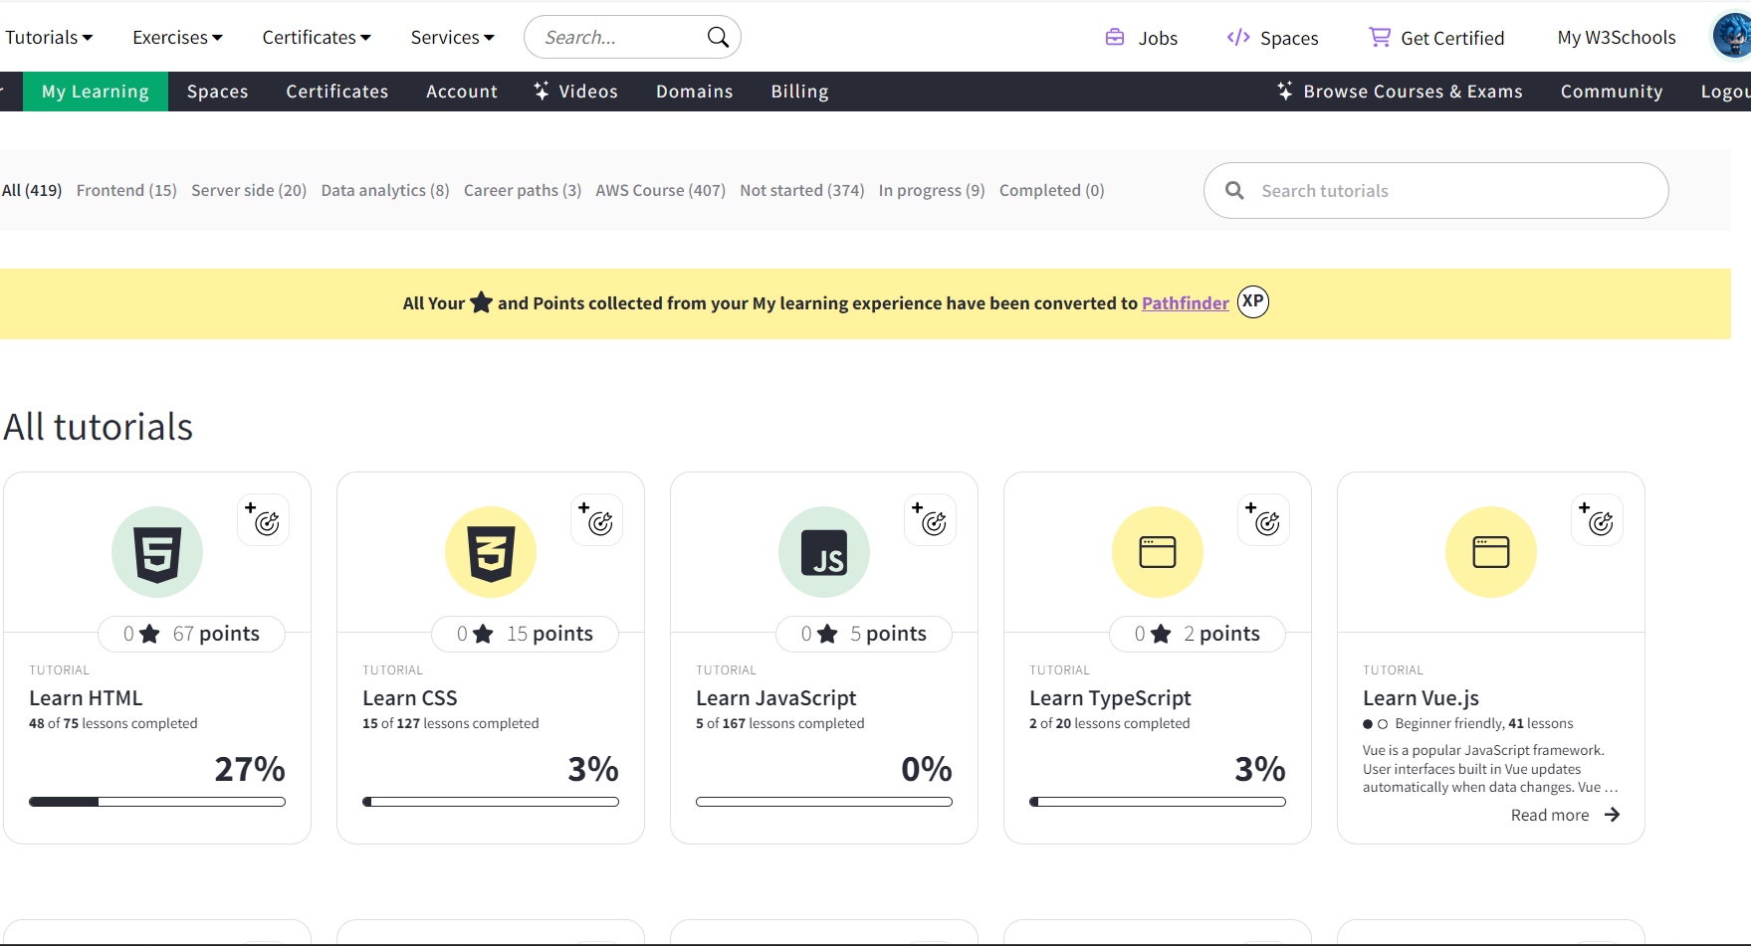
Examples & References :

Slide 11
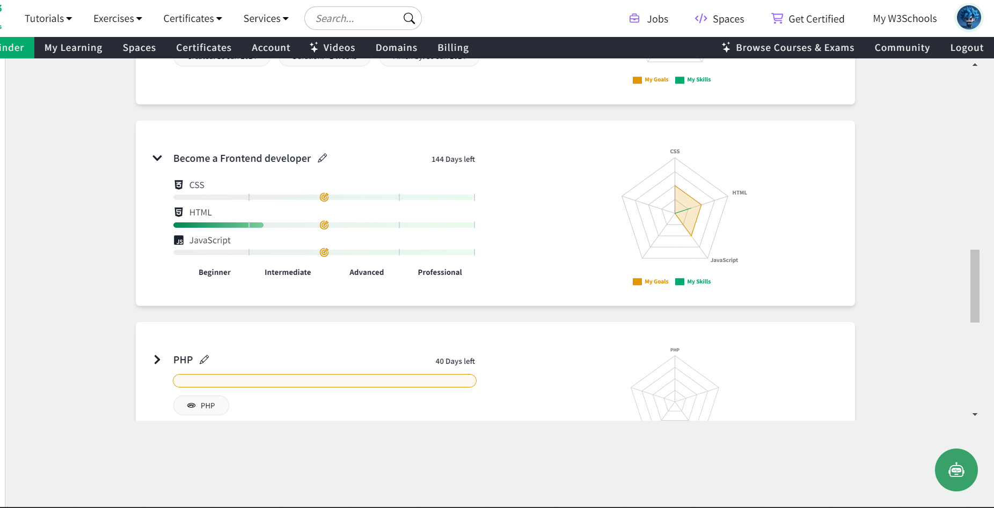
Examples & References :

Slide 12



User-Friendly Roadmaps
Personalized Learning Pathway
A clear and personalized roadmap guiding users through their learning journey, complete with goal-setting strategies.
Visual Representation
Utilizing visual representations to create clear and engaging educational roadmaps tailored to individual learning paths.

Slide 13



Thank You!
We appreciate your time and attention.
Team Members:
RCCODES
Rohan Chauhan
7071 A
CODEVENGERS
GAURAV MISHRA
7001 A

